Slide 1
SE511 Strategic Military Sensors Projects assignments
Dr Ir Xavier Neyt
Professor
Royal Military Academy
Brussels, Belgium

Slide 2
Content
Optical images
Hyperspectral Unmixing
Registration
Co-registration
Orthorectification
Sentinel-2 image: classification
Radar images
SAR image: effect of cloud / rain
SAR image: temporal de-speckling
Generally speaking:
Dataset available on BelADL

Slide 3
Initial conditions
Projects are to be conducted individually
A report is expected, presenting
What was done
Describe the methodology
The results
Including intermediate results
A meaningful & critical analysis
How did you verify that your results were correct?
Are your results plausible/reasonable?

Slide 4
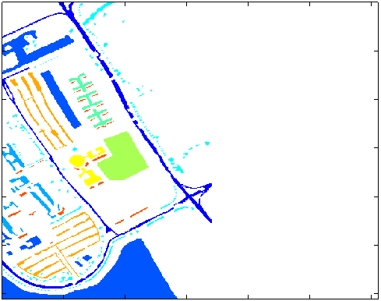
Hyperspectral unmixing
Dataset:
http://www.ehu.eus/ccwintco/index.php/Hyperspectral_Remote_Sensing_Scenes
ToDo:
Extract endmembers from the scene
Evaluate abundance
Ground truth is available
Color corresponds
to a class
(concrete, grass, …)

Slide 5
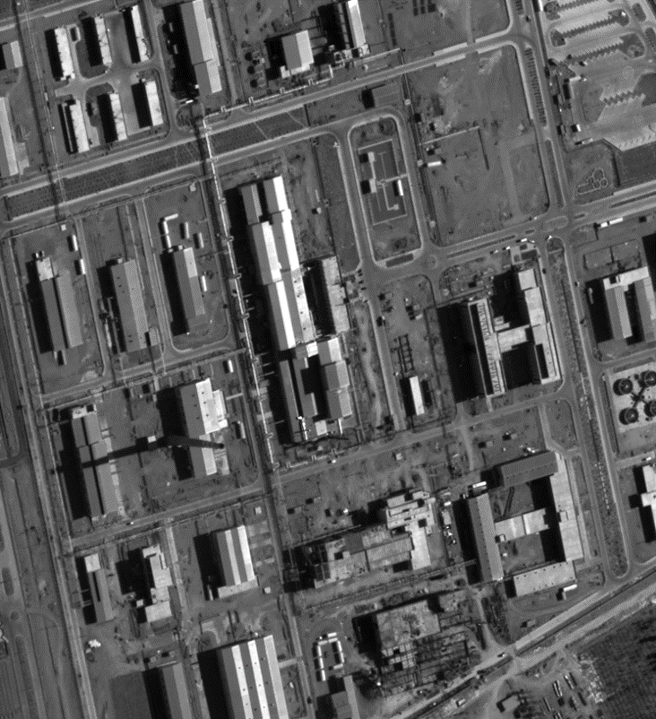
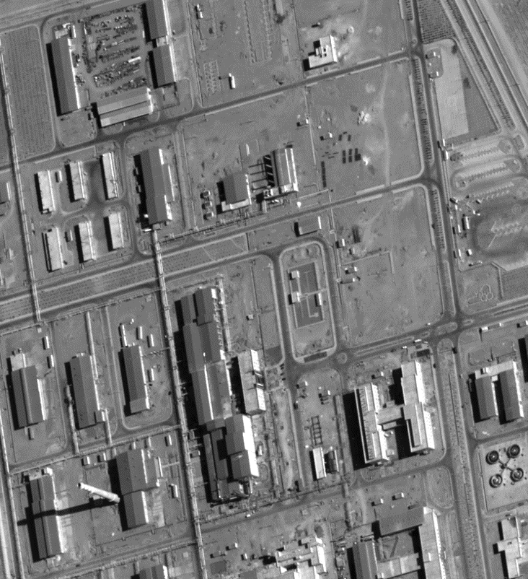
Co-Registration
Image 1 - image 2
ToDo:
Extract GCP (1 a 2)
Compute transform (using a subset of the GCP)
Compute residuals (on unused GCP)
Resample the image

Slide 6
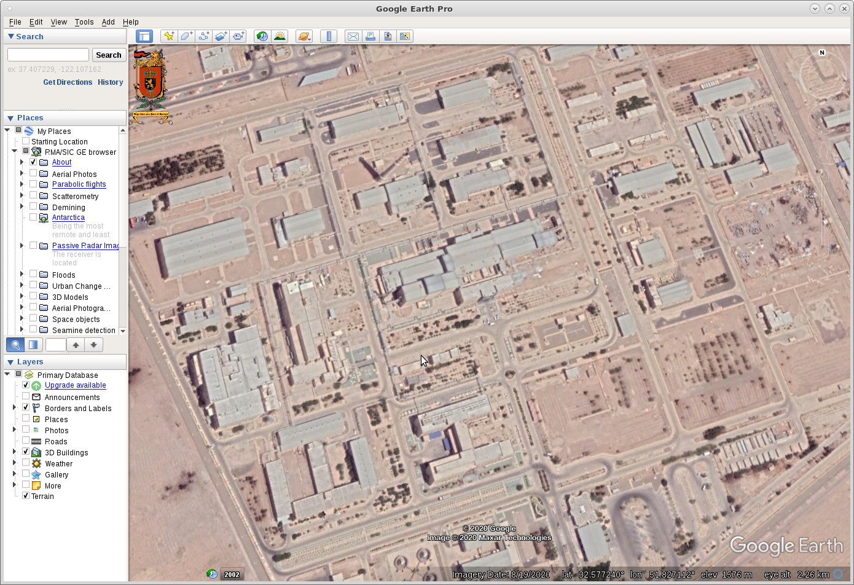
Registration
Image 1 - Google Earth
ToDo:
Similar to Co-registration
Produce KML file…

Slide 7
Orthorectification
Image 1 + Digital Elevation Model
+ Imaging geometry (focal length)
ToDo:
Indirect method suggested
Retrieve altitude from DEM
Compute pixel location in image
Interpolate

Slide 8

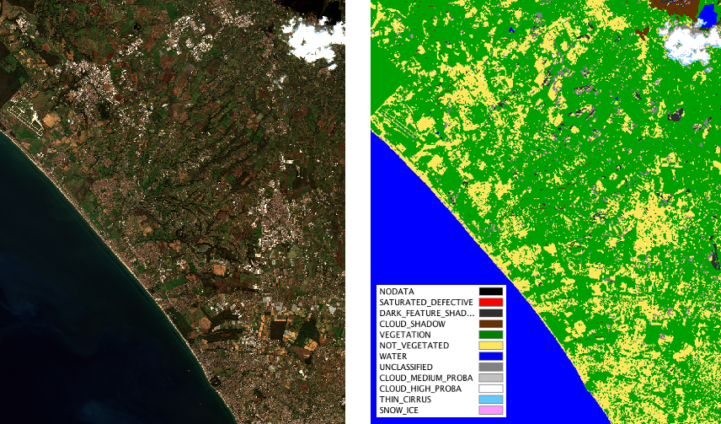
Sentinel2-classification
Sentinel-2 image
ToDo:
Compute band ratios NDVI, NDBI and NDWI
Classify image according to results

Slide 9
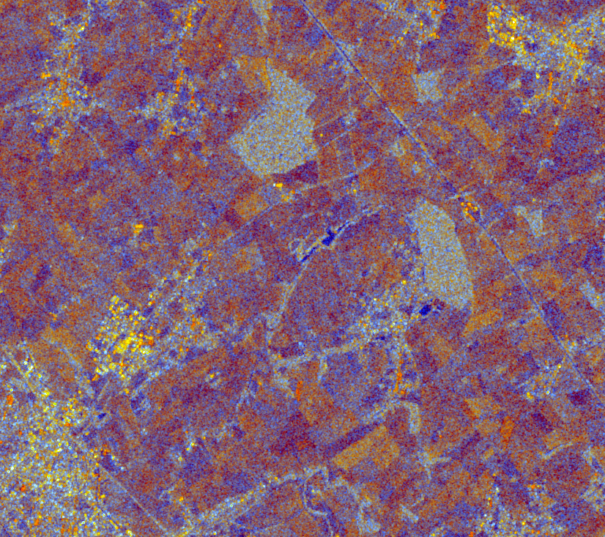
Sentinel1-Effect of clouds
Sentinel-1 image
Central questions: is there a link between clouds & backscatter
Extract cloud map (S2)
Compute sigma0 statistics (mean) when there are clouds & when there are no clouds
Remove effect of sigma0 fluctuations
Analyse results

Slide 10
Sentinel1-Despeckling
Sentinel-1 image
Despeckling
Spatially: Lee-filter : variance/mean over neighbouring pixels
Temporal Lee-filter: variance/mean over time-neighbouring pixels
Exploit S1 time series

Slide 11
Final recommendations
Start working now!
Do not procastinate…
Report due Dec 7th
Should you be stuck or have question
Come and find us!
Make an appointment beforehand…

